Slide 1
INFO 656-01 Fall 2021 What is Machine Learning?
Week 1

Slide 2
Housekeeping
Amir Imani (He/Him)
Email: aimani@pratt.edu
Office Hours: Mondays 7-9. Email me first!
Course website: https://github.com/Amirosimani/Machine_Learning_Pratt
Class discussion (30%)+ 4 Lab Assignments (20%)+ Final Project (10%+30%+10%)

Slide 3
Housekeeping
About the class
Read the required readings, submit 2 interesting points/your ideas/questions you’d like to discuss on Canvas
Break out & class discussions
Lecture (combination of slides + code)
Hands-on section
Guest lecturers
Class discussion (30%)+ 4 Lab Assignments (20%)+ Final Project (10%+30%+10%)

Slide 4

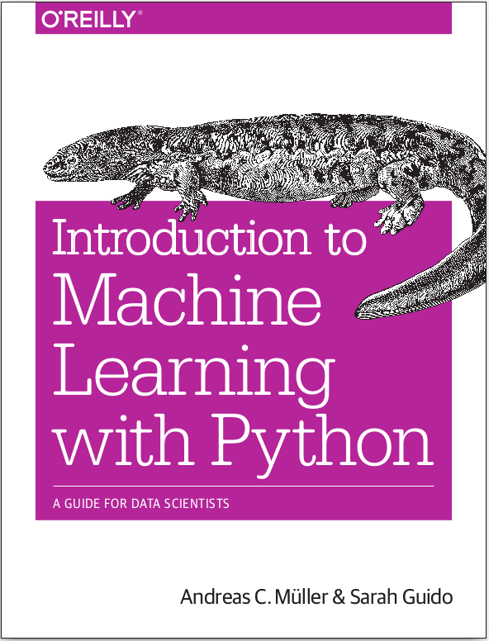


Books
http://ciml.info/

Slide 5
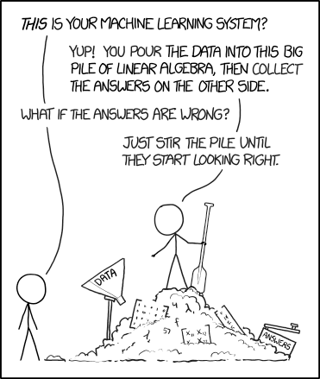
Machine Learning - What and Why

Slide 6
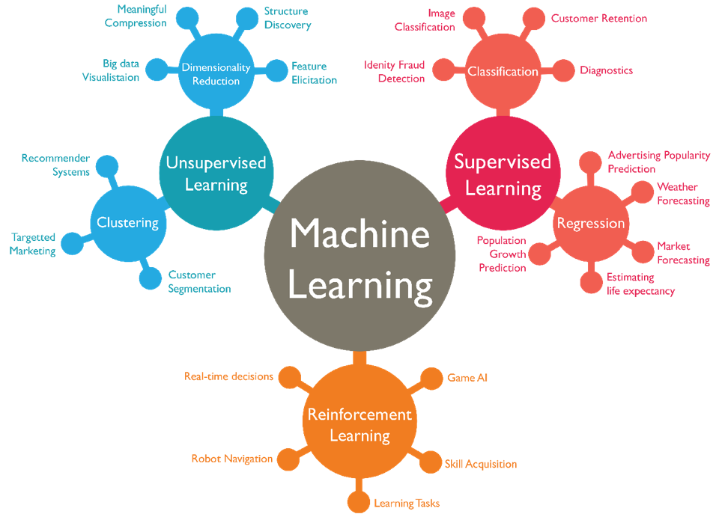
Types of Machine Learning

Slide 7
Other Machine Learning Considerations
Data and the collection process (week 2)
Machine Learning vs Statistics (multiple weeks)
Machine Learning workflow (week 6, 11)
FATML (Fair Accountable Transparent ML) (Week 2, 12, 13)

Slide 8
Coding
Coding is not fun, It’s technically and ethically complex! ¹
Notes:
Regardless of why you are using ML for, you need to code!
What is code? Refer to Bloomberg article
What is algorithm?

Slide 9
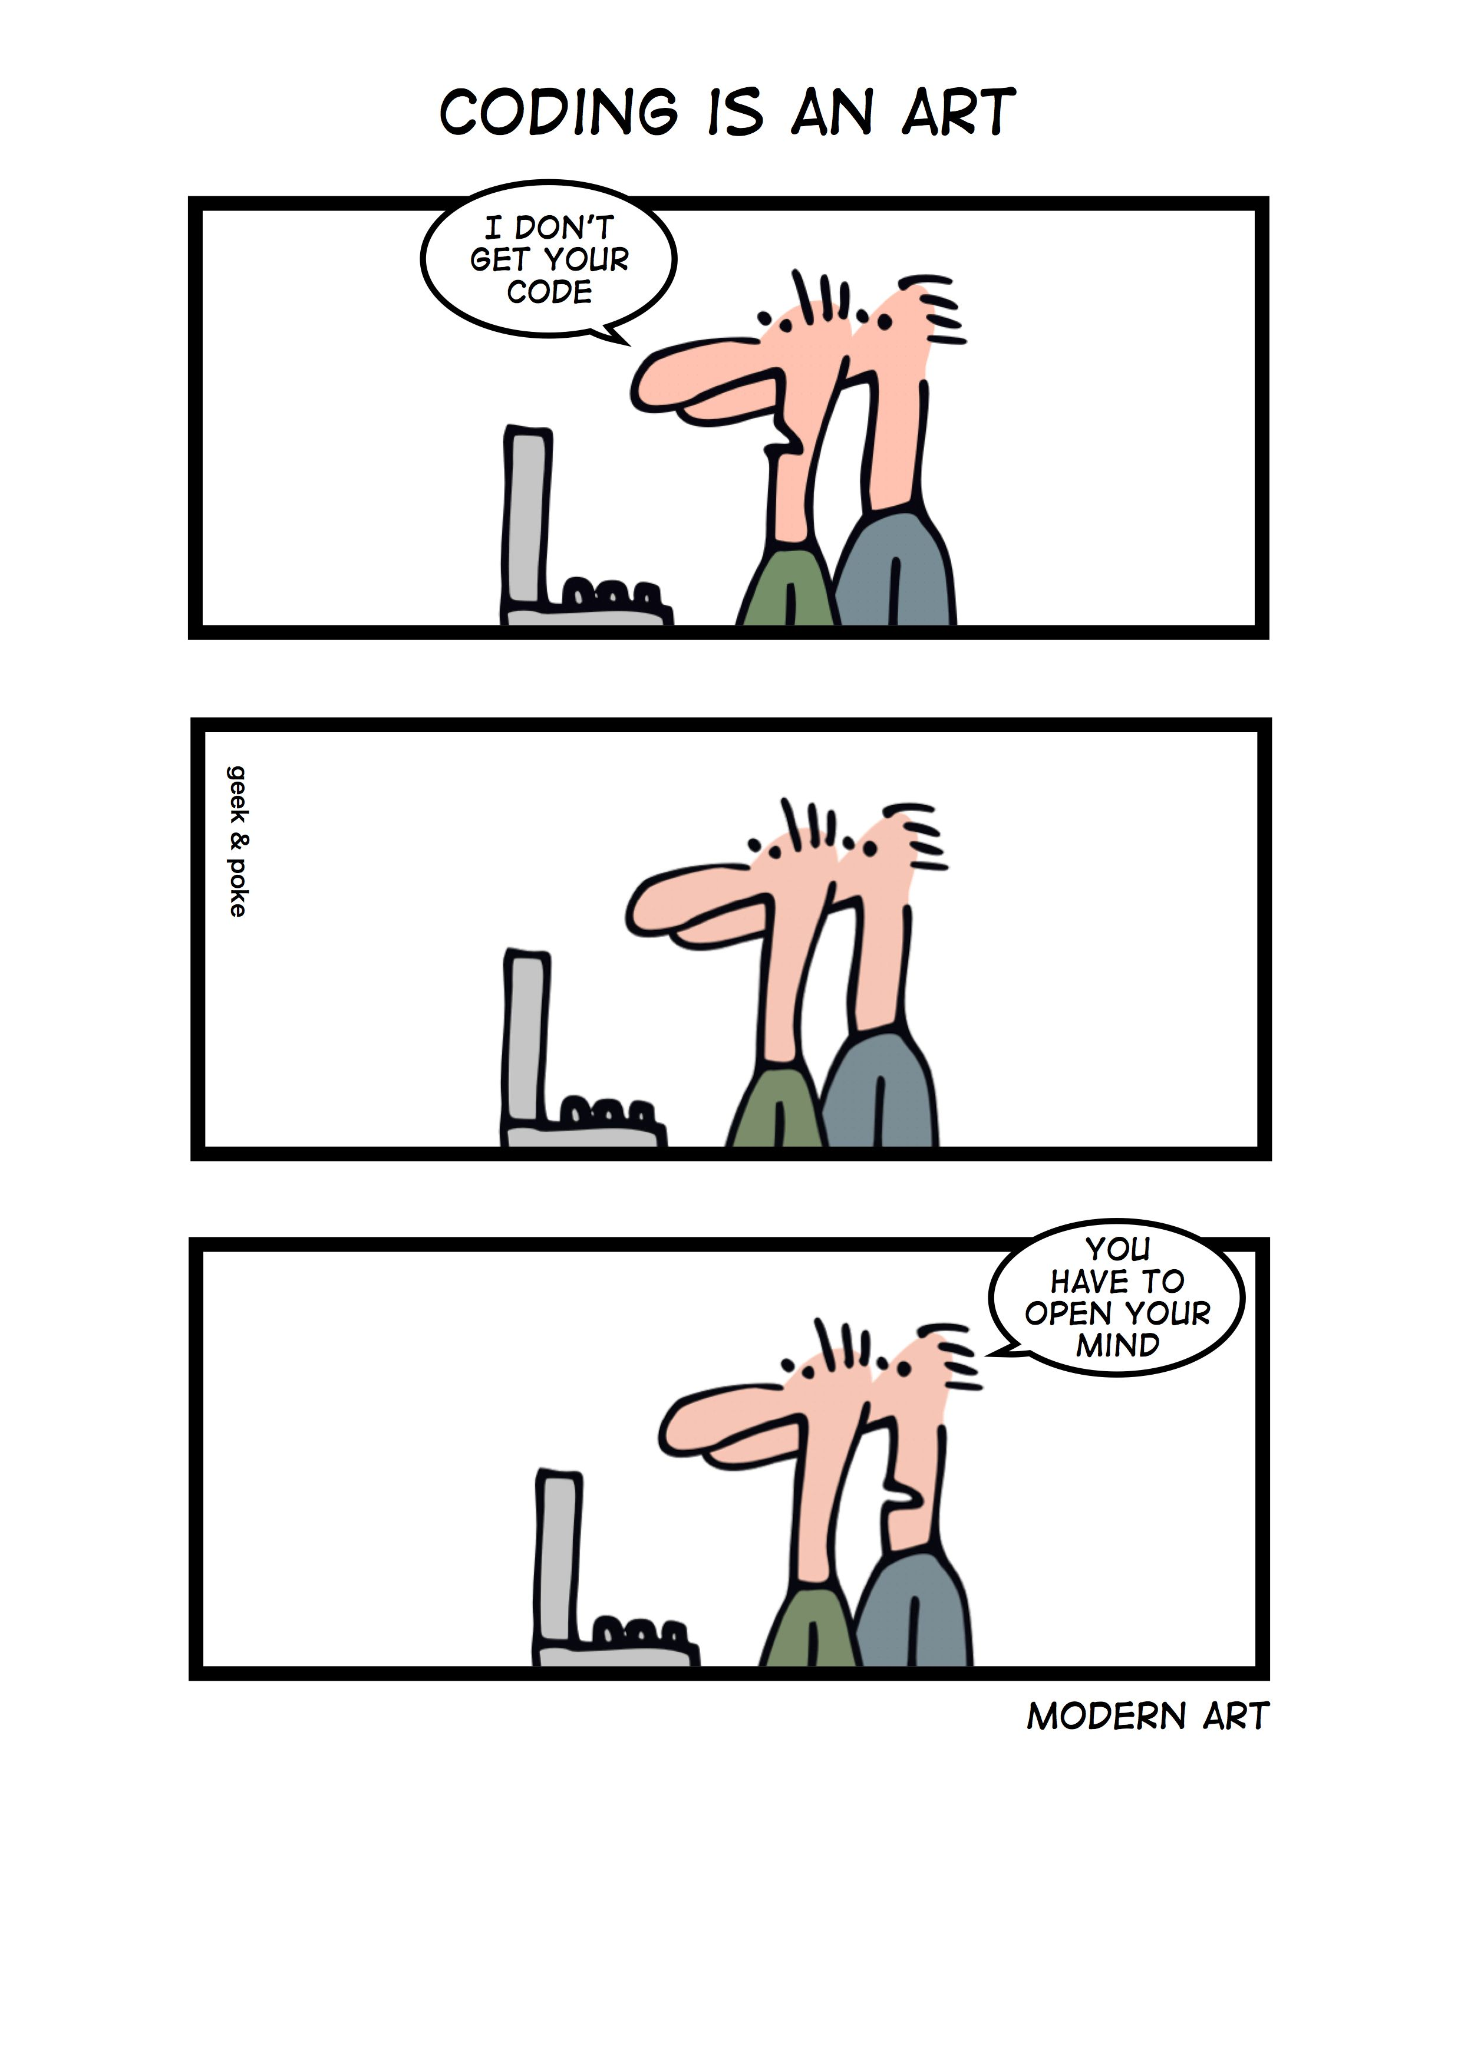
Coding
“Programs must be written for people to read, and only incidentally for machines to execute. ” — Harold Abelson
“Any fool can write code that a computer can understand. Good programmers write code that humans can understand.” — Martin Fowler

Slide 10
General Coding Guidelines
Don’t be clever!
Follow conventions.
Make it readable. Your feature self is the most likely the one who needs to understand it!

Slide 11
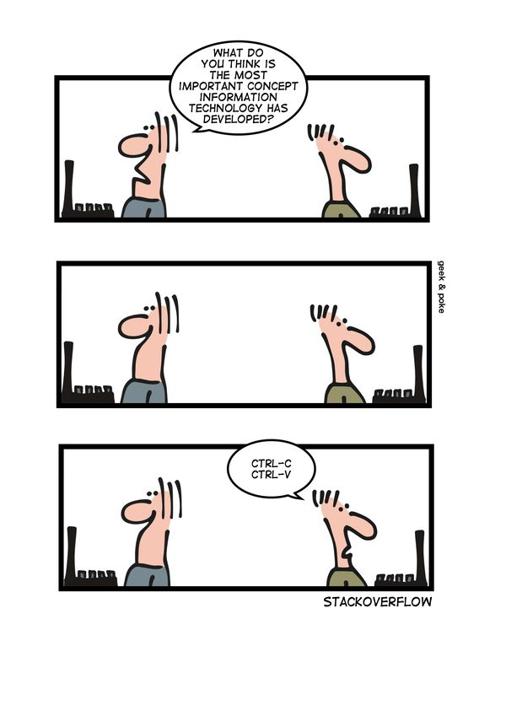
General Coding Guidelines
Don’t be clever!
Follow conventions.
Make it readable.
Avoid writing code.

Slide 12
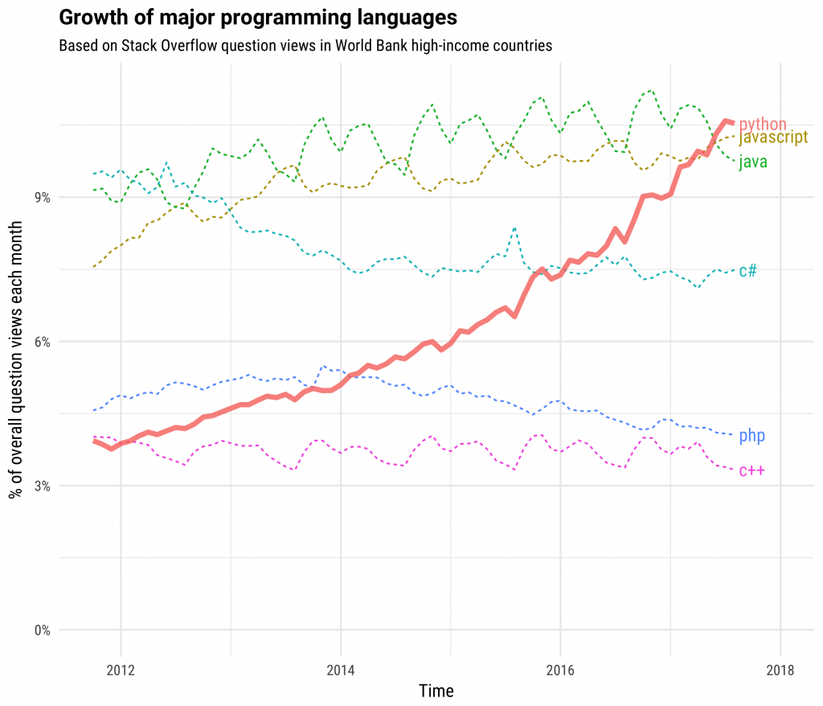
Why Python?
High-level and Interpreted
General-purpose
Multi-paradigm (OOP & Functional)
Modular
Interactive
Dynamic
Great Libraries
Easy to use

Slide 13
Code as an Artifact - Python Good Practices
Don’t use Python 2.x – unless you really have to!
Always create/use environments
Lint your code (PEP8)
Add comments
Modular coding

Slide 14
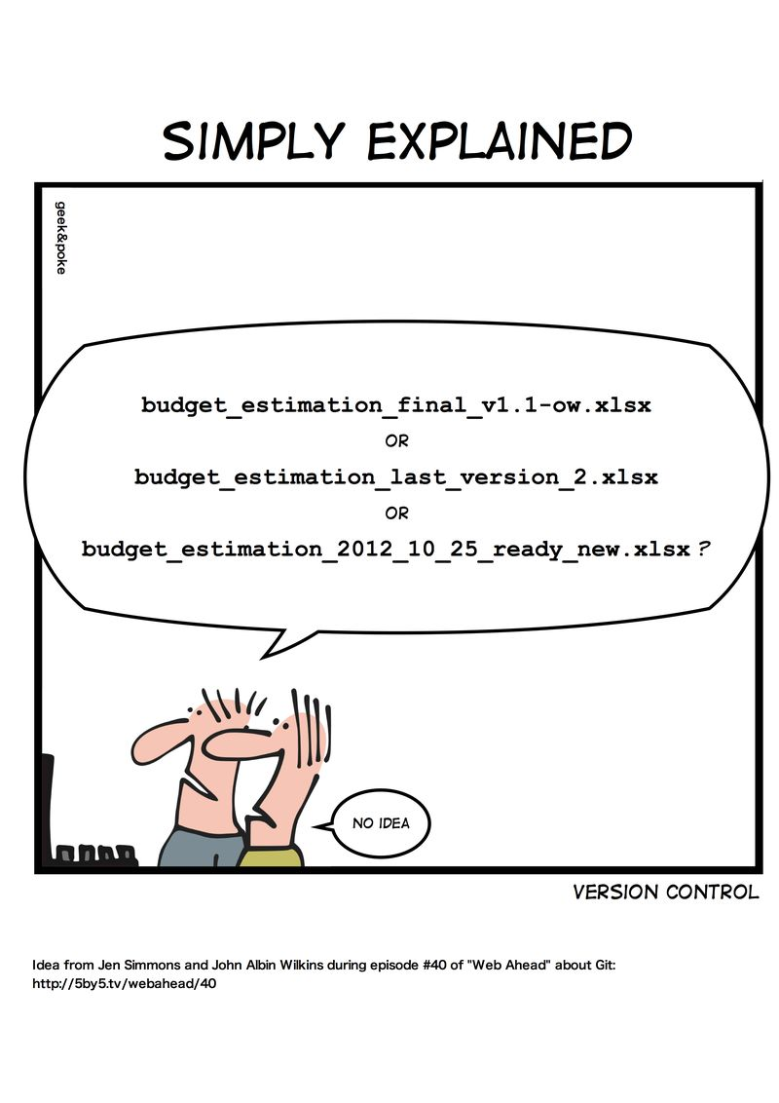
Version Control

Slide 15
Questions?

